Slide 1
Deep Learning - Convolutional Neural Network
(VG-15)
Done By: Goh Rui Zhuo

Slide 2
Business understanding
This is where we will understand the task at hand

Slide 3
The goal of this assignment is to create a CNN model that can best predict the vegetables data
The dataset contains 15 different labels
The data has a train, validation test dataset that enables us to predict the data

Slide 4
Exploratory Data Analysis
Here we will do visualisation on our dataset

Slide 5
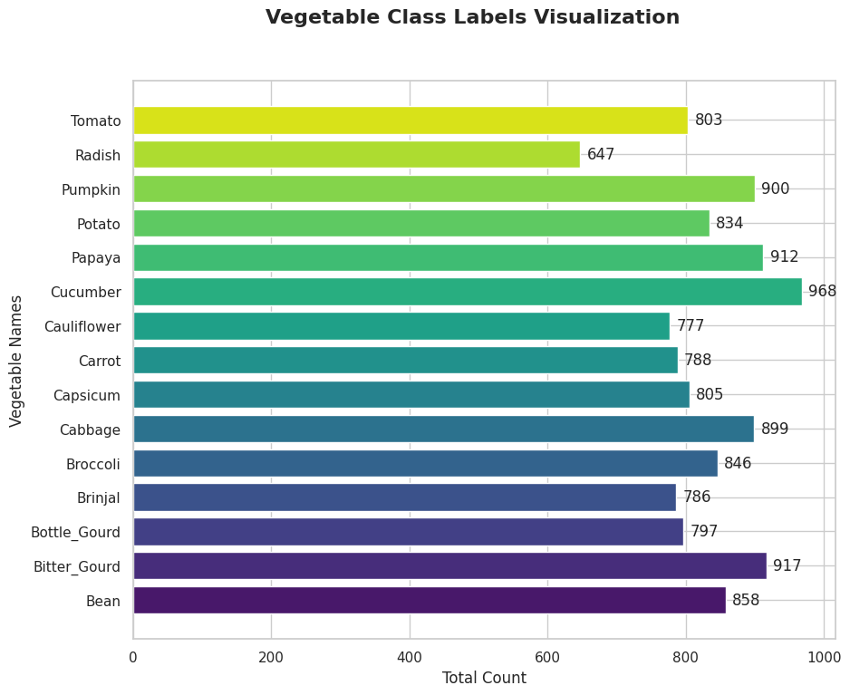
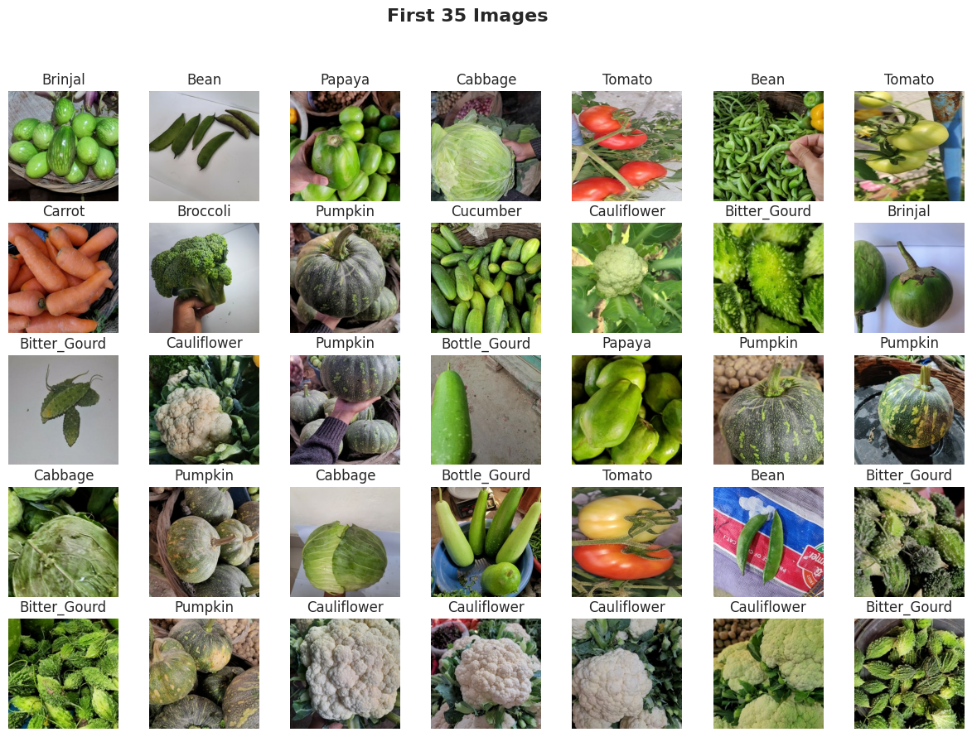
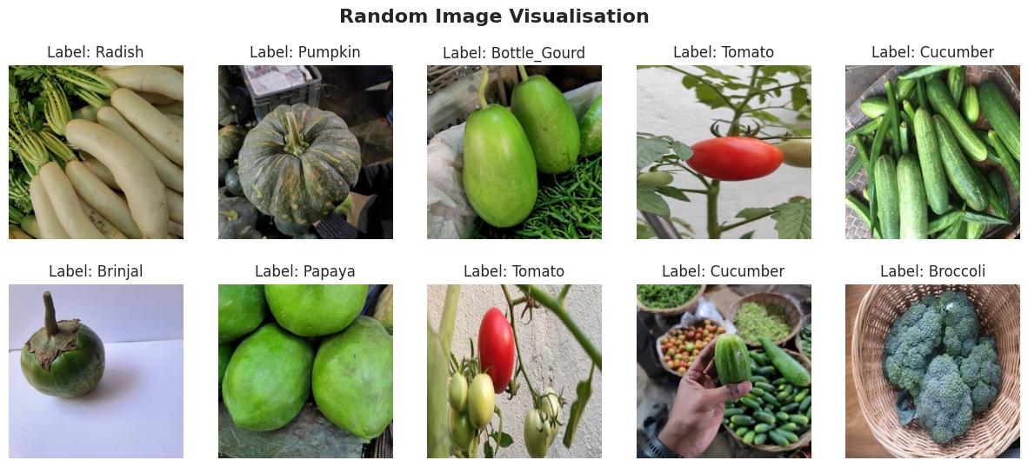
Class Distribution
From the graph, the dataset has Cauliflower as the highest representation at 628 and Radish as the lowest representation at 922
Some form of imbalance dataset can be seen
Random and 35 Image Visualization
Aims to get the quality of the images
All images are of good quality

Slide 6
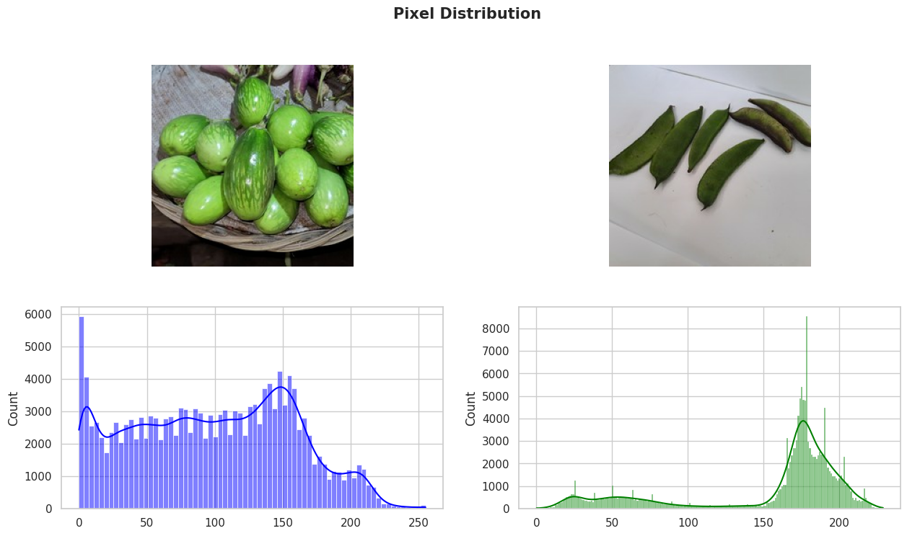
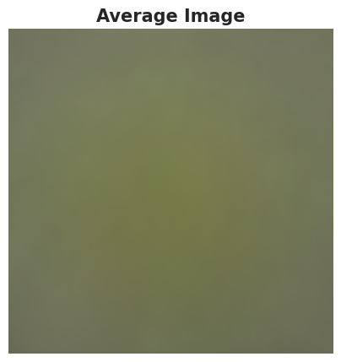
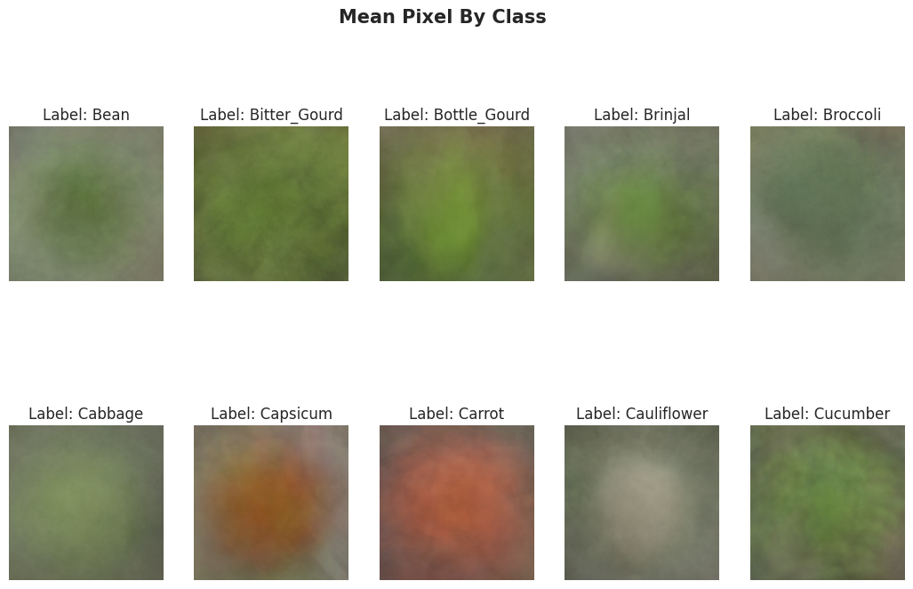
Pixel Distribution
First Images
Significant variance in colour intensity
Contains peaks at 150
Wide variation of colour intensity
Second Images
Smaller number of green beans on a light background
Histogram for this image shows a significant peak around the 200 intensity level, which corresponds to the light background
Mean Pixel Distribution
Average image looks blurry in both whole dataset and by class dataset

Slide 7
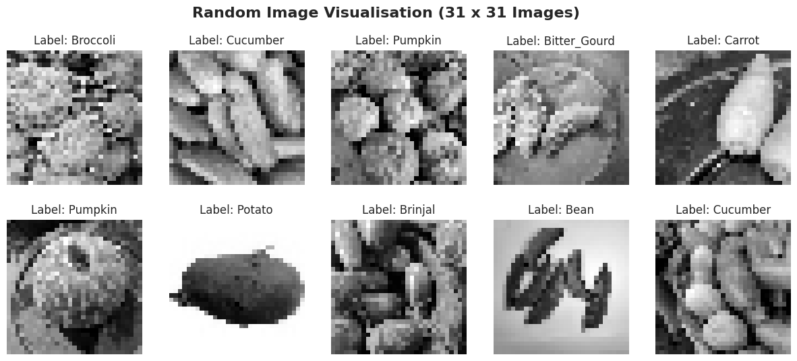
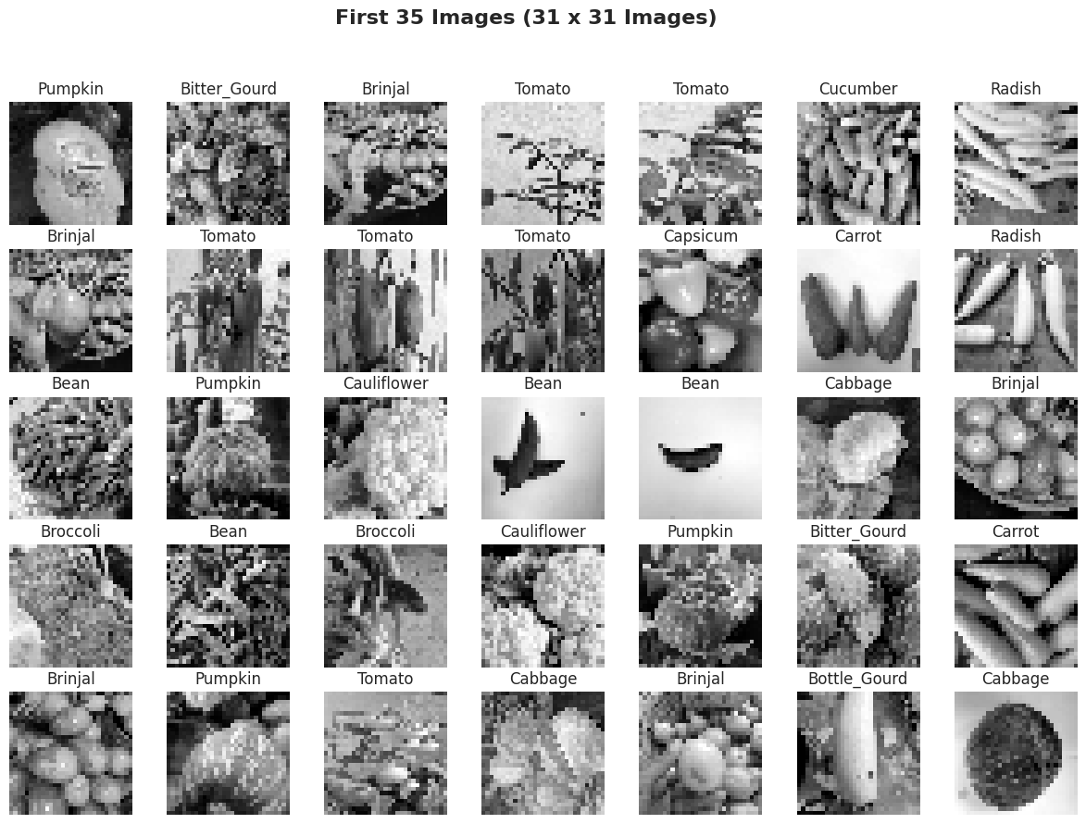
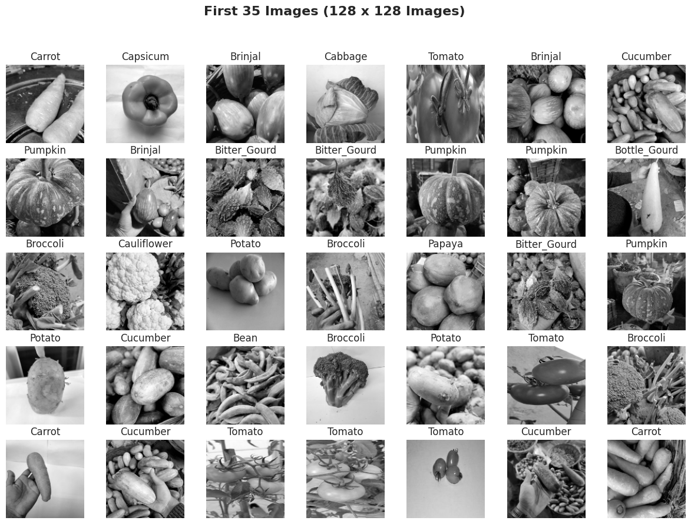
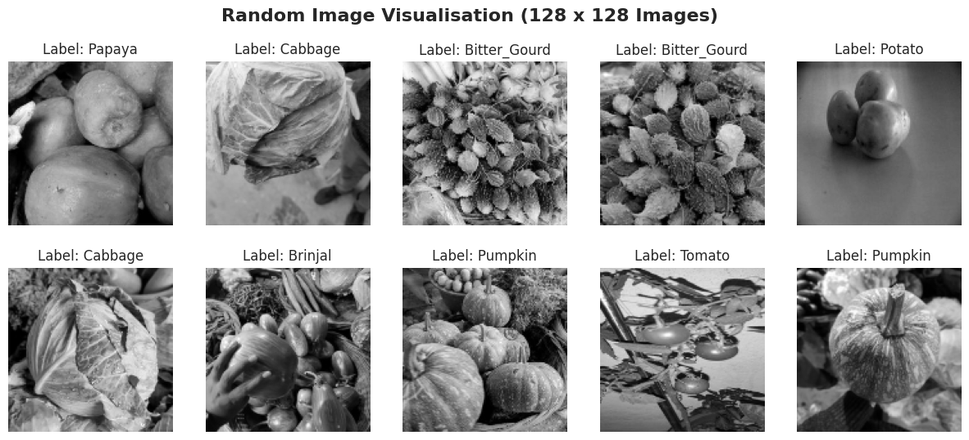
31 x 31 Images
This shows the grayscale images for 31 x 31 images
128 x 128 images
This shows the grayscale images for 128 x 128 images

Slide 8
Evaluation Metrics
Here we will define our evaluation metrics

Slide 9
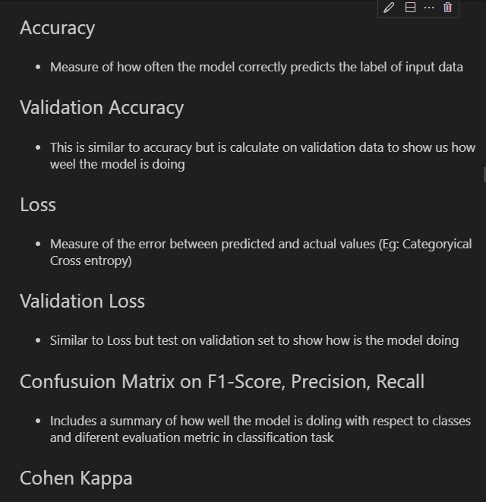
Loss
Accuracy
Kappa Coefficient
Prevent imbalance of class affecting the results of the model

Slide 10
Baseline Model
Here we will develop our first baseline model

Slide 11
31 x 31 Images
Models Created
Baseline Dense Model
Three Dense Block
CNN Baseline 1 Model
2 Convolutional Block with 2 dense block
CNN Baseline 2 Model
Initial Convolutional Block
Three more convolutional block
1 dense layer
Custom VGG 16 model
Increase of layers
Starts at a lower number of filters
Change in conv block (reduce to 3 from 5)
Added regularisation

Slide 12
31 x 31 Images
Models Created
AlexNet
Suited for one colour channel
Change in the number of strides from 4 to 2
Change in second layer size
Batch Normalisation was added
RestNet
Increase the layers
Change the input size

Slide 13
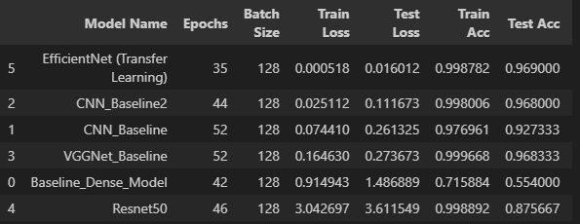
31 x 31 Images
Best Baseline Models
From the validation accuracy we can see that CNN Baseline 2 and CNN Baseline and Custom VGG 16 are the top three models
CNN baseline 2 achieved a validation accuracy score of 96.5%
CNN Baseline has achieved a validation accuracy score of 92.7%
VGG 16 Model achieved a validation accuracy score of 96.5%
All models has similar kappa coefficient score

Slide 14
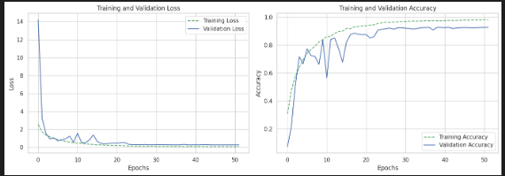
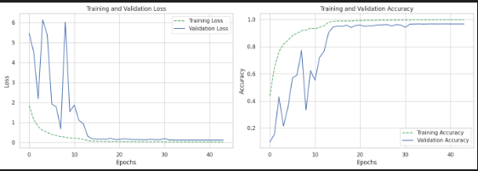
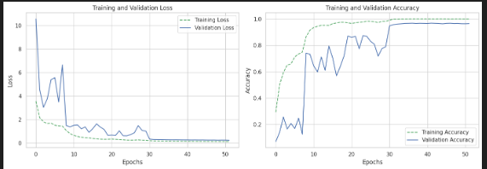
CNN Baseline 1
CNN Baseline 2
Custom VGG model

Slide 15
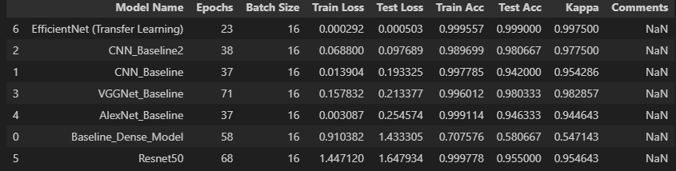
128 x 128 Images
Models
All models are the same
For the convolutional baseline models, additional conv block was added to both of them
Additional VGG 16 block was also added to the custom vgg 16 model
Best Baseline Model
Similar to 31 x 31 images, the best baseline model for 128 is vgg16, cnn baseline 2 and cnn baseline
CNN baseline 2 achieved a validation accuracy score of 94%
CNN Baseline has achieved a validation accuracy score of 98%
VGG 16 Model achieved a validation accuracy score of 98%

Slide 16
Data Preprocessing /Feature Engineering
Here we will dod Preprocessing of the dataset

Slide 17

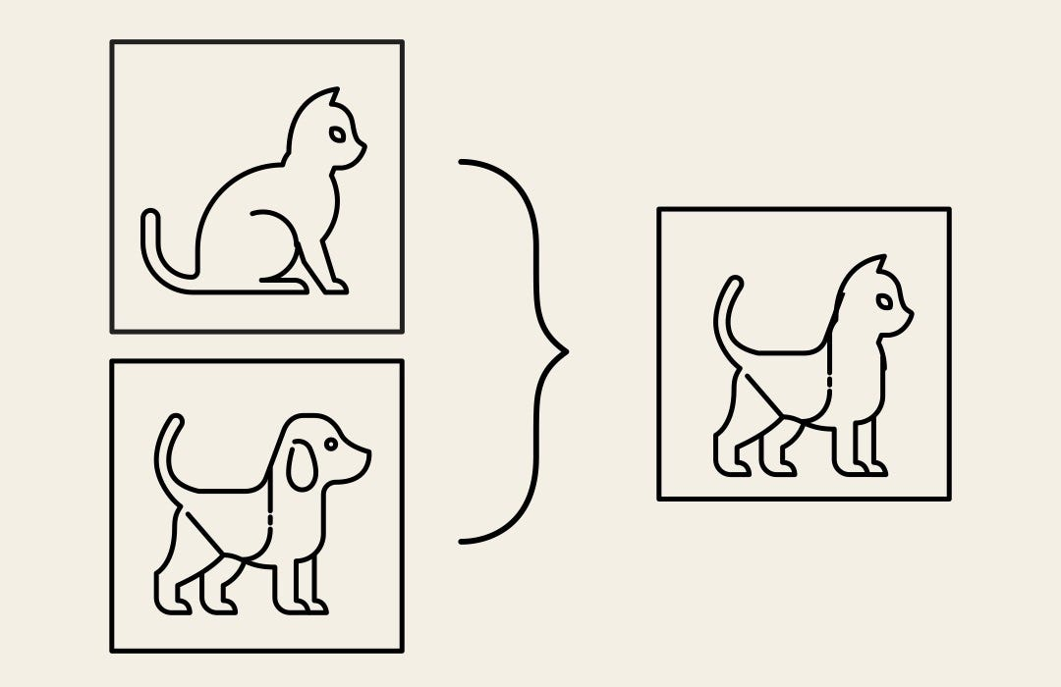
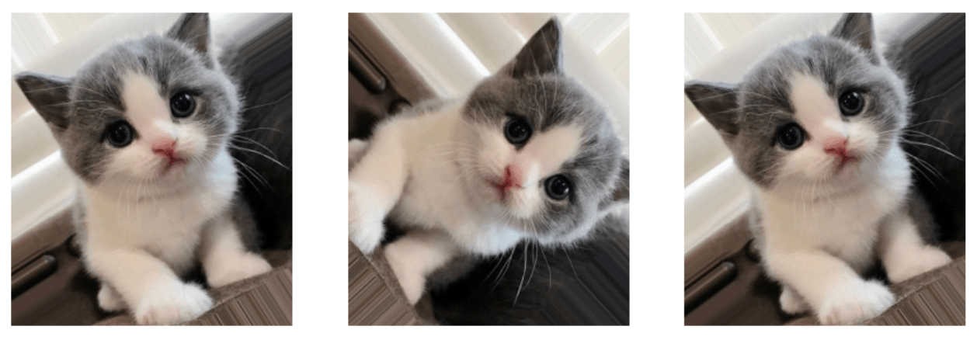
Why data augmentation?
Model is still able improve further
Lets see if data augmentation helps with the model training
Techniques for data augmentation
CutMix
CutOut
Random rotating and flipping of iamges

Slide 18
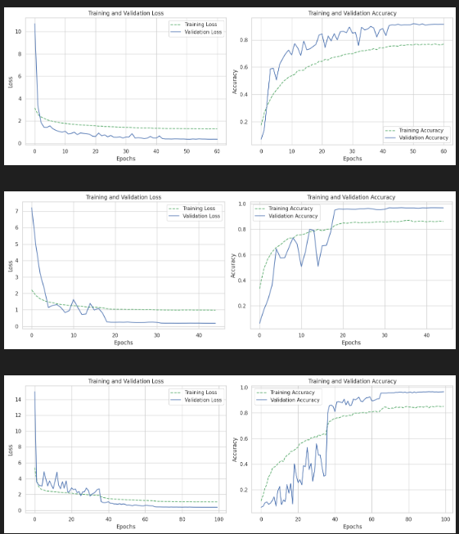
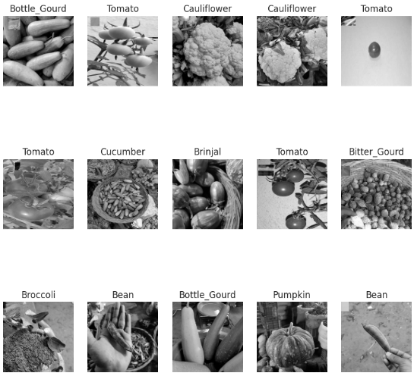
31 x 31 Images
Best data augmentation techniques is cut mix
CNN2 improved from 96.5% to 97%
VGG 16 Improved from 96.5% to 96.6%

Slide 19
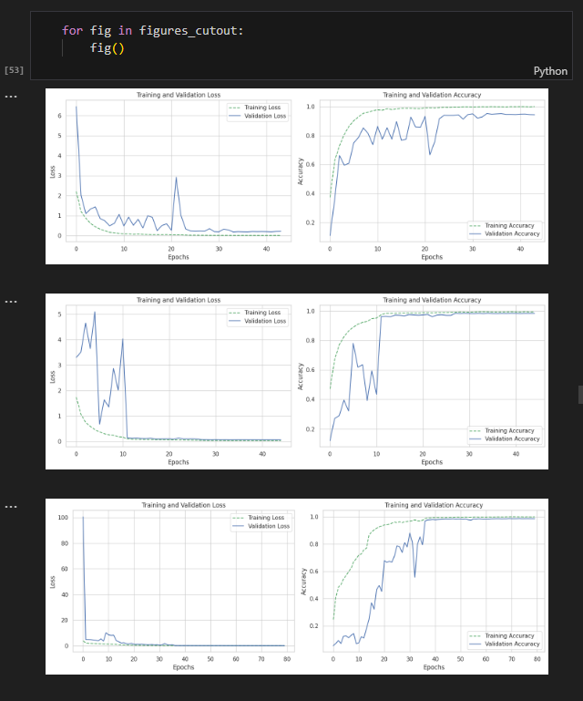
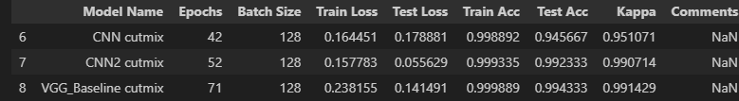
128 x 128 Images
Best data augmentation techniques is cutmix
VGG16 and CNN2 improved from 97.5% to 98%
CNN 1 also improve from 93 to 94%

Slide 20
Model Improvement -Adding Regularisation
Here it is to add Regularisation to the model

Slide 21
128 x 128 and 31 x 31 Images
Adding regularisation prevents the possible overfitting of the dataset
However, in both of this case, the validation score did not perform well compared to previous models where there was no overfitting

Slide 22
Model Improvement -Adding Cosine Annealing
Here is to try and use learning rate scheduler

Slide 23
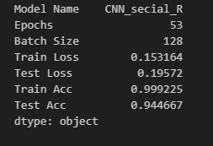
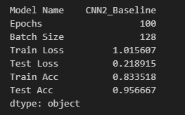
128 x 128 and 31 x 31 Images
Adding cosine annealing helps to find the minimum point more effectively
However, in both of this case, the validation score did not perform well compared to previous models where there was no overfitting

Slide 24
Hyperparameter Tuning
Here is where we try to tune to parameter

Slide 25
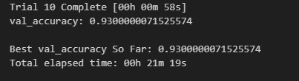
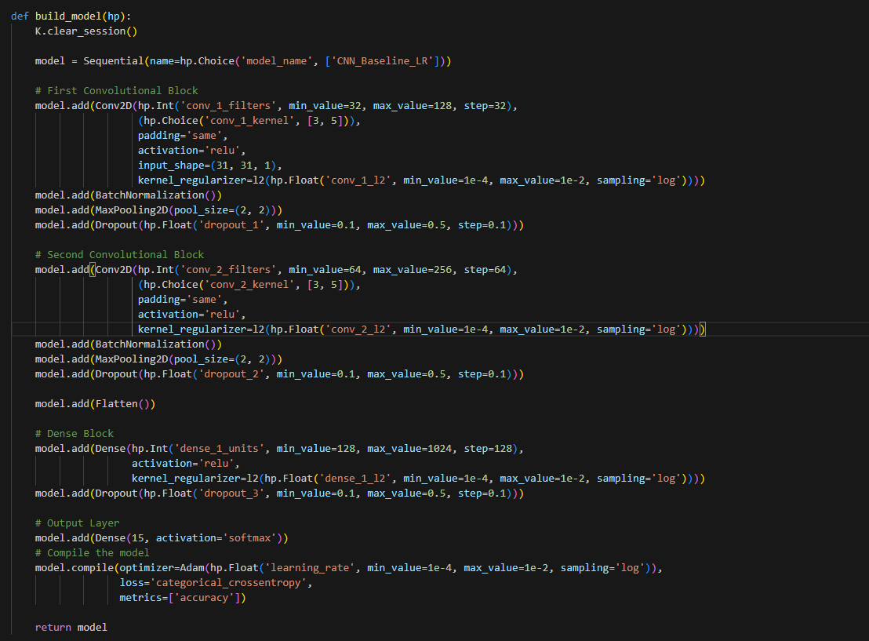
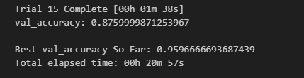
128 x 128 and 31 x 31 Images
With random search, we tune the number of conv blocks, types of activation, types of regularisation and also the number of neurons
However, the model did not show any improvement when using hyperparameter tuning

Slide 26
Auto Encoder
Here we try to detect the outliers of the image and see if removing helps

Slide 27
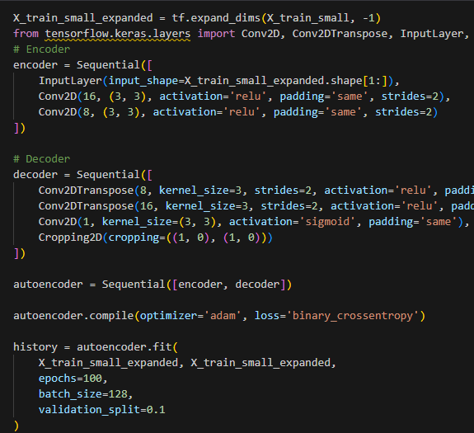
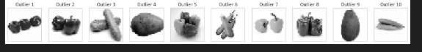
128 x 128 and 31 x 31 Images
With autoencoder, we try to remove the outliers from the dataset
Below shows the separation of the data and only non outliers was use in training of model
However, for both image size, the validation score did not improve

Slide 28
Final Model
Here we will set the final model

Slide 29
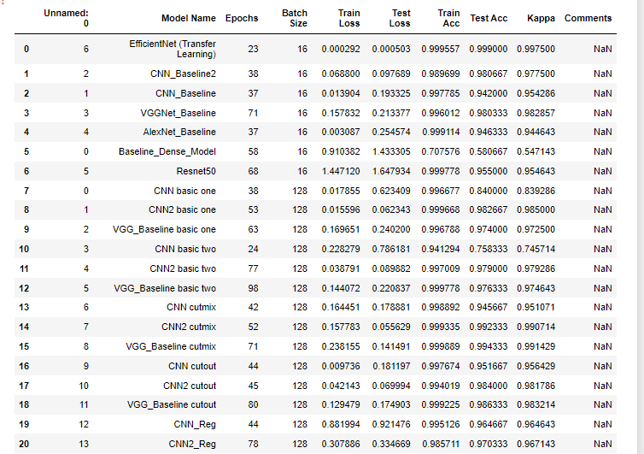
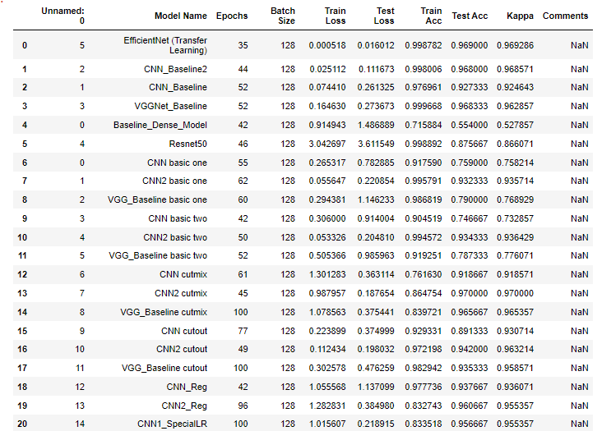
In general,
The 128 x 128 images generally performed better than the 31 x 31 images

Slide 30
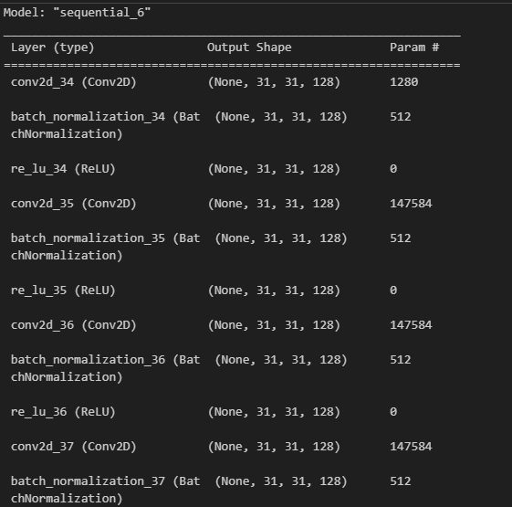
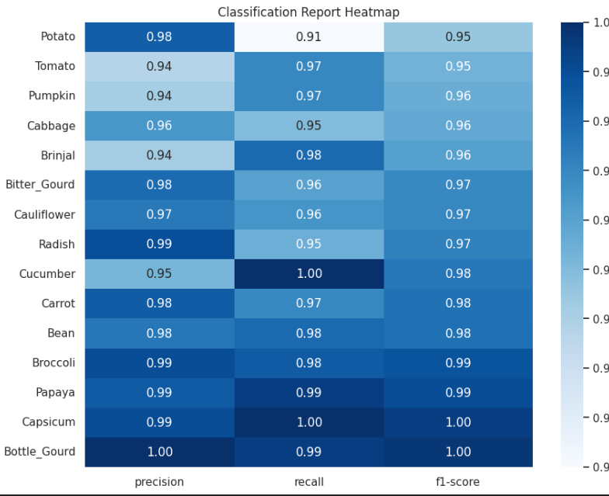
31 x 31 Images
Best Model: CNN2 with cutmix
Achieved 97.2 validation and test accuracy
Model is best at prediction Bottle Gourd and worst at Potato in terms of f1 score
Cohen Kappa score is also at 97%

Slide 31
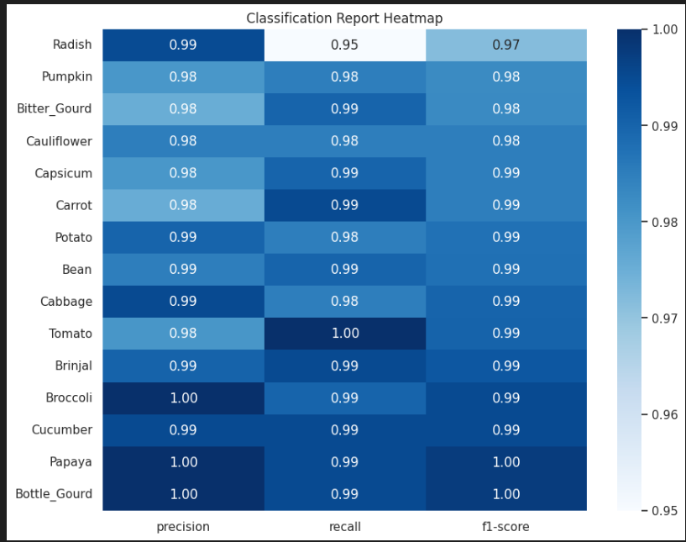
128 x 128 Images
Best Model: CNN2 with cutmix
Achieved 99.2 validation and 98.8 test accuracy
Model is best at prediction Bottle Gourd and worst at Radish in terms of f1 score
Cohen Kappa score is also at 98,75%

Slide 32
Overall, the model performed extremely close to a transfer learning model of efficient net at 99.5%. This model is very suitable for predicting vegetables and with such a small dataset

